Slide 1
ARM11 – Assembler & Emulator
17th June 2021
Extension: A Concurrent Application of Blockchain Mining and Exchange in C
Ashvin Arsakularatne
aa9220@ic.ac.uk
Kavya Chopra
kc2320@ic.ac.uk
Siddhant Singh
ss5120@ic.ac.uk
Ye Lun Yang
yly19@ic.ac.uk

Slide 2
EMULATOR

Slide 3
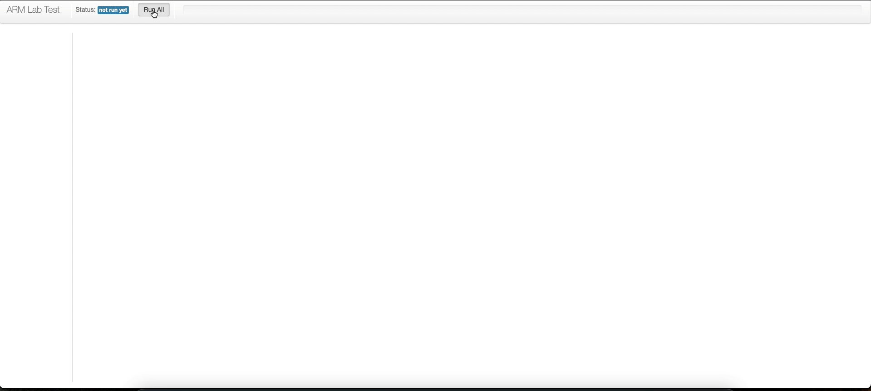
Test Cases

Slide 4
Interesting Test Case #1

Slide 5
Interesting Test Case #2

Slide 6
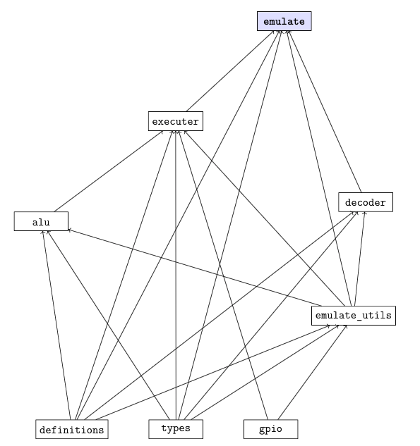
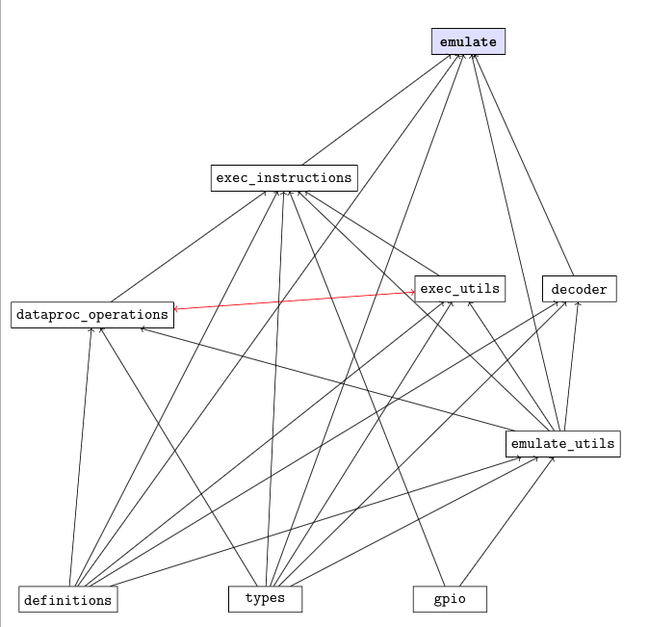
Cyclic File Dependencies

